Slide 1

HEART DISEASE DETECTION USING MACHINE LEARNING
GUIDE:
Mrs.G.Julin Leeya, M.Tech.,
CSE Department
UCEA
BATCH MEMBERS:
Arunkumar R [513319104006]
Nithish Kumar B [513319104022]
Panneerselvam K [513319104025]
Surya A [513319104041]

Slide 2
ABSTRACT
For Heart Disease prediction we use new dataset which weren’t used in recent years.
Replacing with new Machine Learning algorithms which gives better result and also for futuristic work.
We use undersampling and oversampling to overcome data imbalancing.
And we use cluster type architecture to group the people with similar health condition.

Slide 3

ARCHITECTURE DESIGN FOR PROPOSED SYSTEM
Database
user
Data requirements for prediction of heart disease
Pre-processing
Predicting data imbalance
Scaling with under sampling and oversampling
Finding null values etc
Heart disease predictor’s result
Accuracy result
Deriving result with values
Accuracy prediction using algorithms

Slide 4
ER DIAGRAM
Age
BMI
Patient Details
Gender
PHY Value
Alco
Y/N
CPR No
(cardiopulmonary resuscitation)
Lab Results
Cholestrol
Vital Details
Smoke
Y/N
Diabetic

Slide 5
DFD DIAGRAM
User
Feed
The
Values
Extract
The
Features
Predict
The
Heart
Disease
Classify
The
data
Match
The
Features

Slide 6
ALGORITHMS USED
DECISION TREE: Decision trees can handle large datasets and can be easily parallelized to improve processing time. It performs classification without requiring much computation
LOGISTIC REGRESSION: It is used for solving the classification problem. It makes no assumptions about distributions of classes in feature space. It uses logistic function which gives sigmoid curve.
STOCHASTIC GRADIENT DESCENT: It is more efficient for large datasets.It is memory-efficient. Finding minimalist and maximizing problems.
ADA: AdaBoost, also called Adaptive Boosting, is a technique in Machine Learning used as an Ensemble method. It combines with random forest and decision tree with periodic stumps.
XGB: It is an implementation of Gradient Boosted decision trees. It utilizes the power of parallel processing and that is why it is much faster than GBM.

Slide 7
REFERENCES
Avinash Golande, Pavan Kumar T, Heart Disease Prediction Using Effective Machine Learning Techniques, International Journal of Recent Technology and Engineering, Vol 8, pp.944-950,2019.
T.Nagamani, S.Logeswari, B.Gomathy, Heart Disease Prediction using Data Mining with Mapreduce Algorithm, International Journal of Innovative Technology and Exploring Engineering (IJITEE) ISSN: 2278-3075, Volume-8 Issue-3, January 2019.
Fahd Saleh Alotaibi, Implementation of Machine Learning Model to Predict Heart Failure Disease, (IJACSA) International Journal of Advanced Computer Science and Applications, Vol. 10, No. 6, 2019.
Anjan Nikhil Repaka, Sai Deepak Ravikanti, Ramya G Franklin, Design And Implementation Heart Disease Prediction Using Naives Bayesian, International Conference on Trends in Electronics and Information(ICOEI 2019).
Theresa Princy R,J. Thomas,Human heart Disease Prediction System using Data Mining Techniques, International Conference on Circuit Power and Computing Technologies,Bangalore,2016.
Nagaraj M Lutimath,Chethan C,Basavaraj S Pol.,Prediction Of Heart Disease using Machine Learning, International journal Of Recent Technology and Engineering,8,(2S10), pp 474-477, 2019.
UCI, Heart Disease Data Set.[Online]. Available (Accessed on May 1 2020): https://www.kaggle.com/ronitf/heart-disease-uci.
Sayali Ambekar, Rashmi Phalnikar,Disease Risk Prediction by Using Convolutional Neural Network,2018 Fourth International Conference on Computing Communication Control and Automation.
C. B. Rjeily, G. Badr, E. Hassani, A. H., and E. Andres, Medical Data Mining for Heart Diseases and the Future of Sequential Mining in Medical Field, in Machine Learning Paradigms, 2019, pp. 7199.
Jafar Alzubi, Anand Nayyar, Akshi Kumar. "Machine Learning from Theory to Algorithms: An Overview", Journal of Physics: Conference Series, 2018

Slide 8
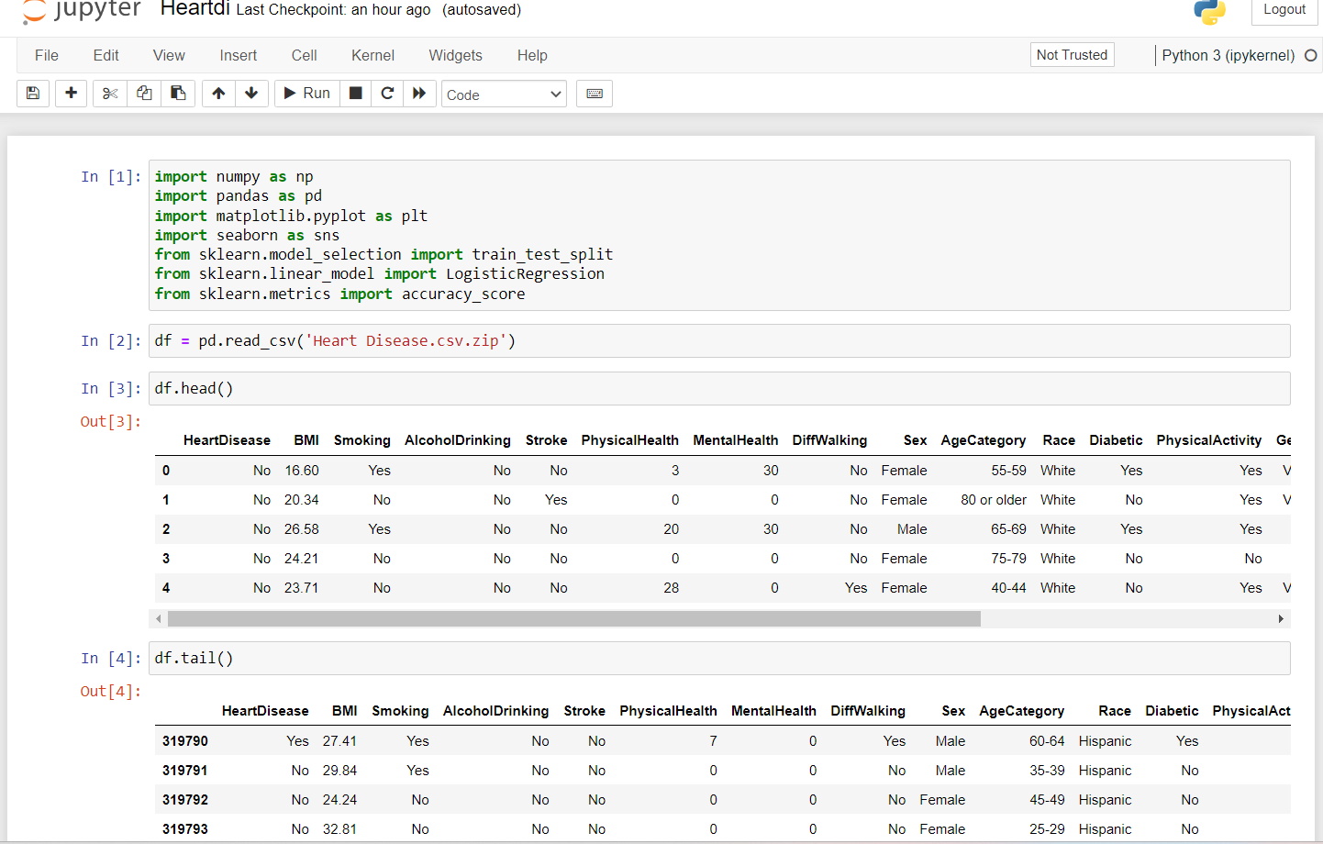
CODE IMPLEMENTATION

Slide 9
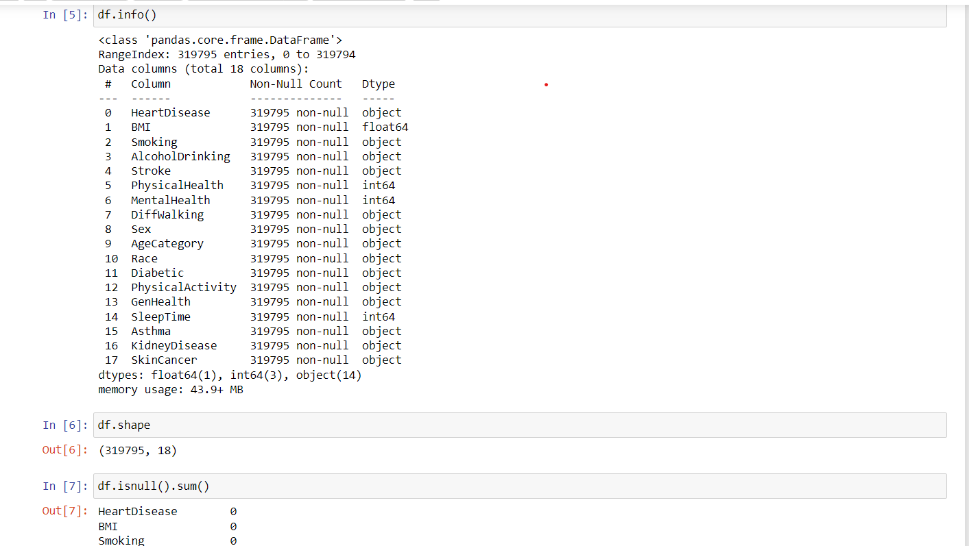

Slide 10
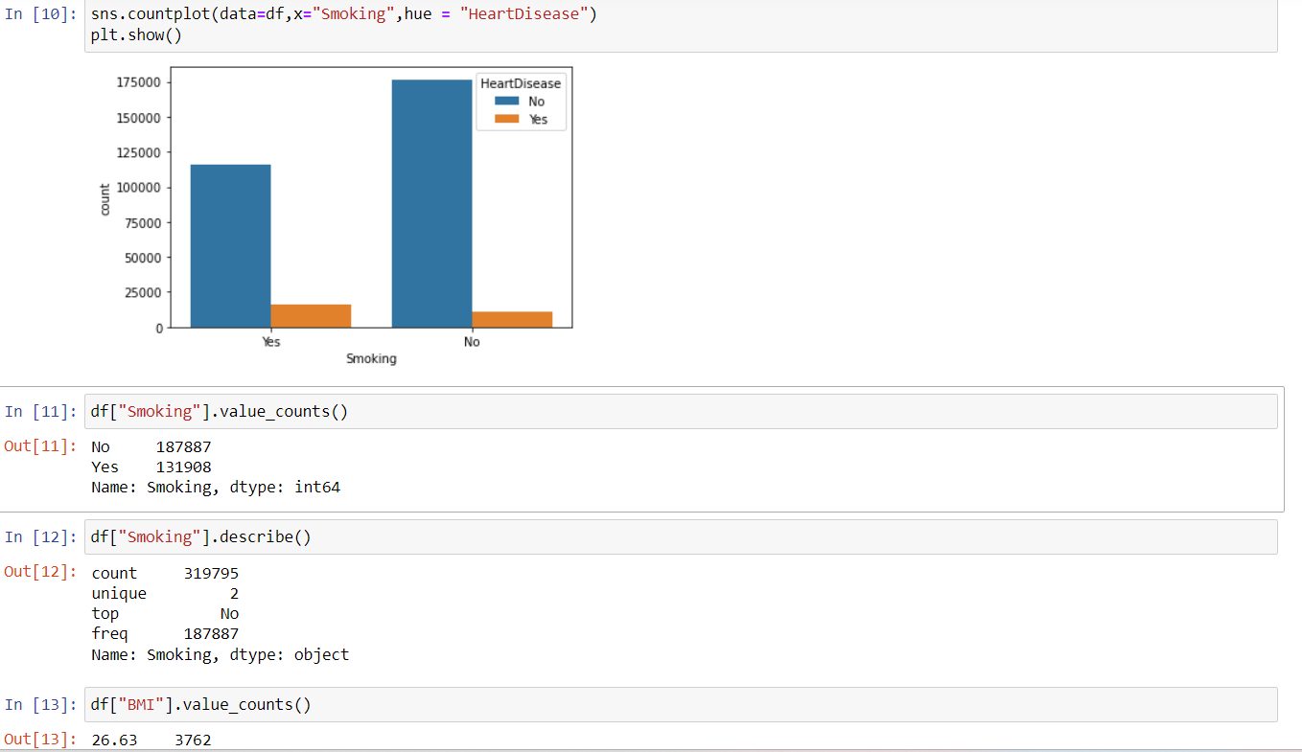
CODE IMPLEMENTATION

Slide 11
THANK YOU!

